Slide 1


DEPI Final Project
Ahmed Mohamed Anwer

Slide 2
Track : IBM Data Scientist
Group : CLS CAI1_AIS3_S3e
Instructor : ENG. Karim Ahmed

Slide 3

Project Idea 2 Sales Forecasting and Optimization
RFM Analysis of bikes store in Australia

Slide 4


Agenda
Data Collection and Exploration
Data Analysis and Visualization
Forecasting Model Development
Deployment and stream-lit

Slide 5

Data Collection and Exploration

Slide 6
About dataset
Dataset provides information of bike store sales for the year 2017 in Australia. The dataset contains four sheets with valuable insights into customer demographics, addresses, and transactions.
Customer Demographic: Contains the customers' age, gender, Job, about the customer base.
Customer Address: Provides the geographical information for customers, including address, state, and postal code.
New Customer List: Features newly added customers to the store in 2017. This data is crucial for tracking customer acquisition and growth trends.
Transactions: Contains transaction details such as transaction ID, date, product details, and total purchase amount.

Slide 7
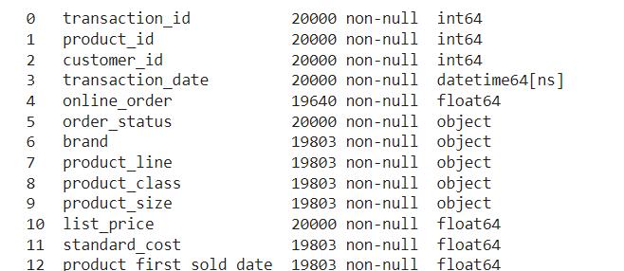
Data Exploration transactions_sheet.info()
Unique id for every transaction
Identifies the product involved in the transaction.(Foreign Key)
Identifies the customer involved in the transaction.(Foreign Key)
The date when the transaction occurred.
Indicates whether the transaction was an online order (TRUE for online, FALSE for offline).
The status of the order (Approved, Cancelled).
The brand of the product involved in the transaction.
Specifies the product line, such as Road, Touring, Standard, or Mountain.
Classification of the product in terms of quality or level, such as high, medium, or low.
The size of the product, for example, large, medium, or small.
The product’s price at the time of the transaction.
The cost incurred by the company to produce or purchase the product.
Represents the date when the product was first sold.

Slide 8
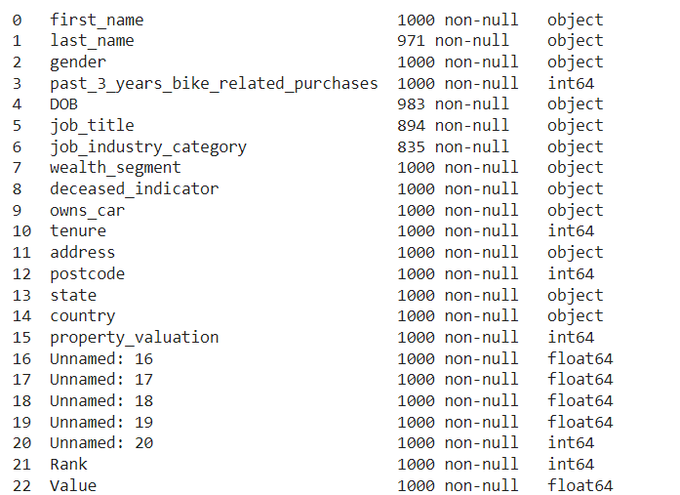
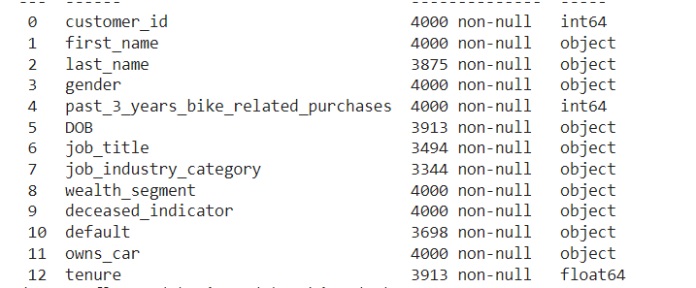
Newcustemorst_sheet.info() customerdemographic_sheet.info()
Contain details of the new customers
Name
Gender
Recent related bike purchase
Job
Date of birth
Owns car (yes or no)
Specific location
Tenure: The length of time (in years) the customer has been associated with store.
Deceased indicator : Indicates if the customer is deceased (Y for yes, N for no)
customer’s wealth (Mass, Affluent, High Net Worth)

Slide 9
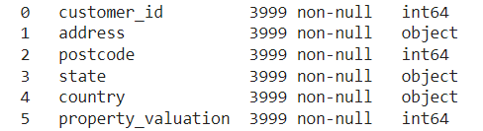
Customeraddress_sheet.info()
Unique identifier for customers.
The exact address of the customer
The postal code associated with the customer's address.
The state where the customer
The country of residence (Australia).
Numeric representing the property valuation rating.

Slide 10

Data Analysis and Visualization

Slide 11

Data cleaning and preprocessing
Handling missing values
Checking for duplicates
Remove nonrelevant columns
Validity and data quality

Slide 12
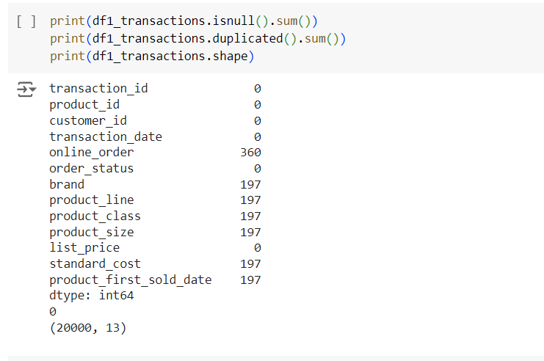
Handling missing values and duplicates : In sheet one there is no duplicated values, but we got number of null values in different columns. However, the number of missing values is quite small compared to size of data, also we can observe the missing values refers to uncomplete transactions. So, the optimal solution here is to drop missing values from dataset.
Preparing sheet one

Slide 13
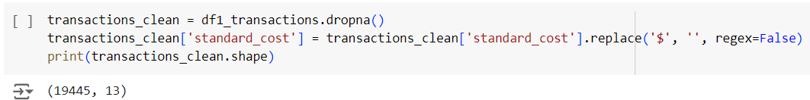
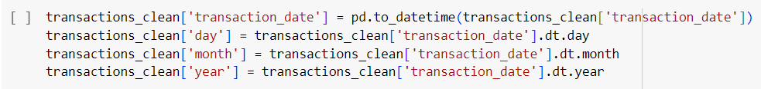
Validation and quality : converting “standard_cost” column by removing “$”. Splitting “transaction date” into day, year and month.
Preparing sheet one

Slide 14
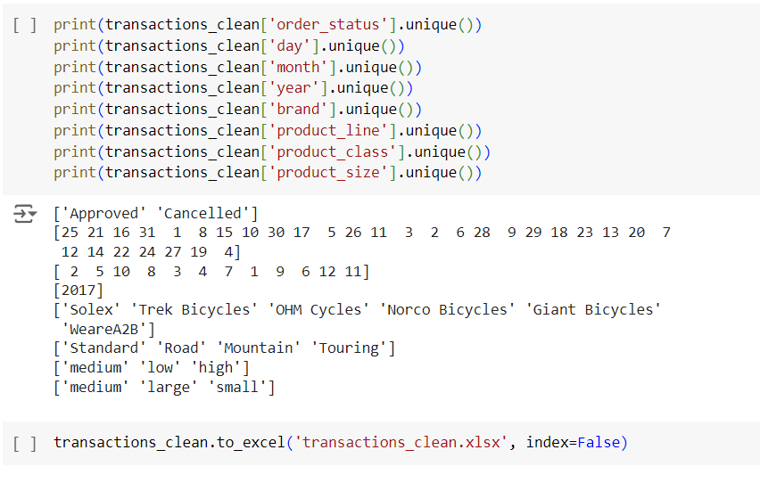
Validation and quality : Checking unique values and saving data.
Preparing sheet one

Slide 15
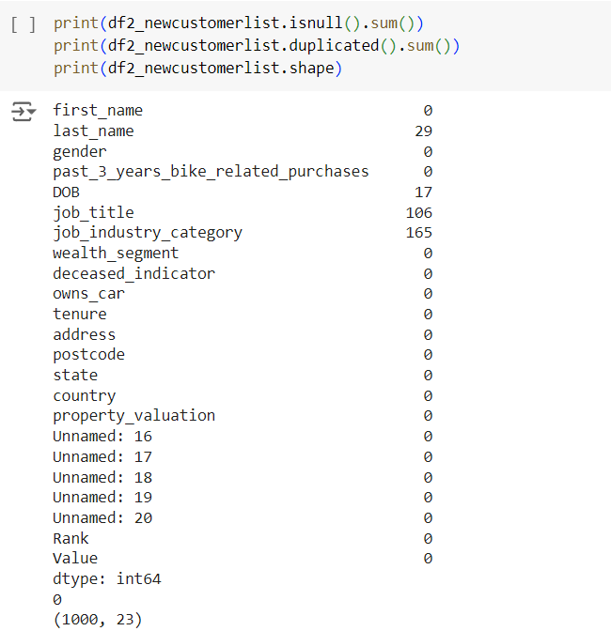
The sheet contains missing values in categorical data that probably refers to unemployed people. Dropping this number of records will affect our data because they are much compared the size The sheet contains five unnamed columns
Preparing sheet two

Slide 16
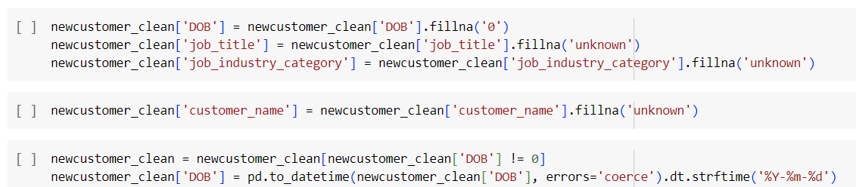
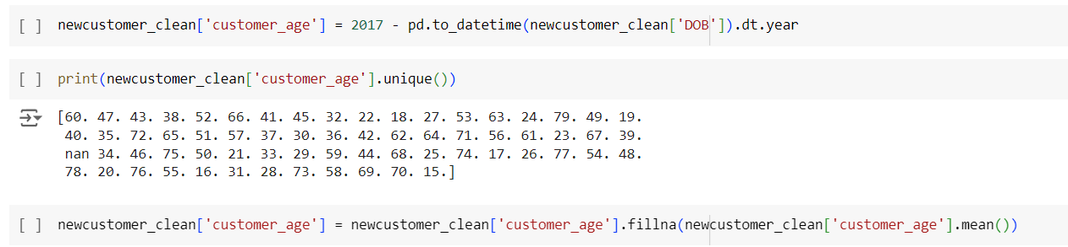
Preparing sheet two
Remove unnamed column
Fill null with unknow , remove null from DOB column , convert DOB to calculate customer age

Slide 17
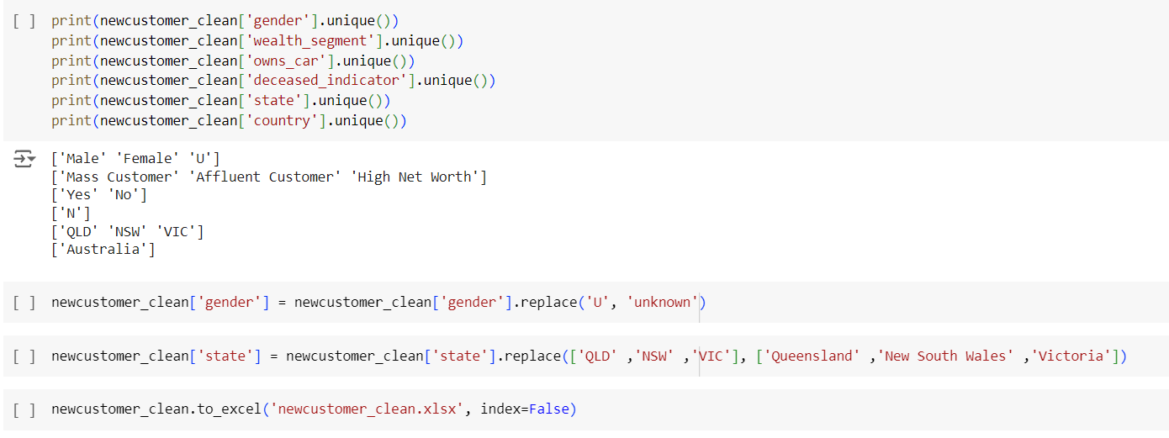
Preparing sheet two
Checking unique values
Replace the inconsistent data with more readable values

Slide 18
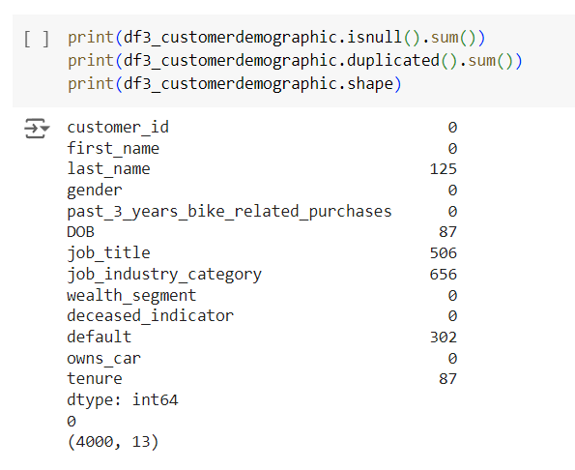
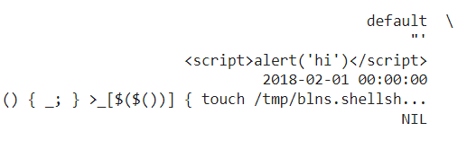
Preparing sheet three
The sheet contains missing values in categorical data that probably refers to unemployed people.
Number of missing values in “tenure” and “DOB”.
Non relevant column “default”

Slide 19
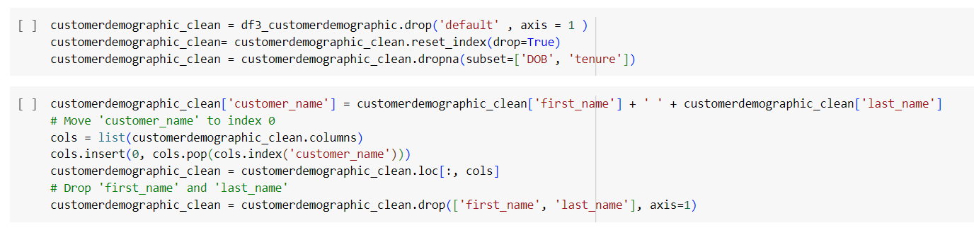
Preparing sheet three
Drop “default” column
Drop nulls by “DOB” and ”tenure”
Removing “first_name” and “last_name” then concatenate them to “customer_name”
Fill categorical missing values with “unknwon”

Slide 20
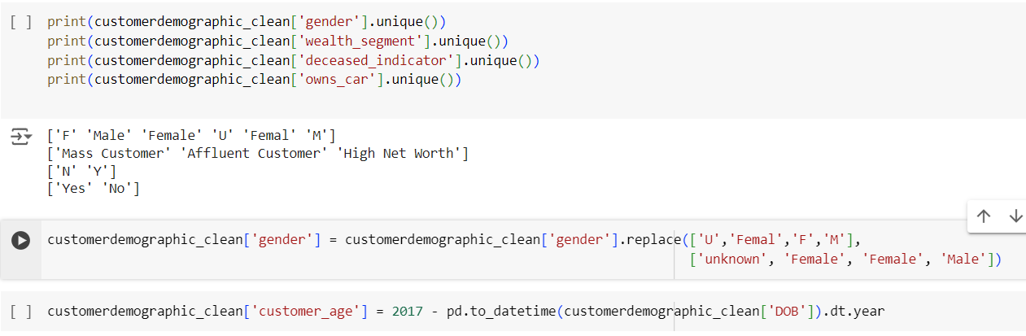
Preparing sheet three
Checking unique values
Replace the inconsistent values
Calculating customer age

Slide 21
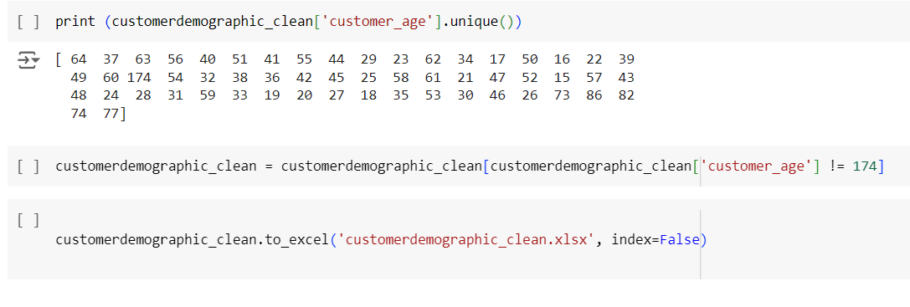
Preparing sheet three
Delete the record with age 174 (inconsistent value value)
Save data

Slide 22
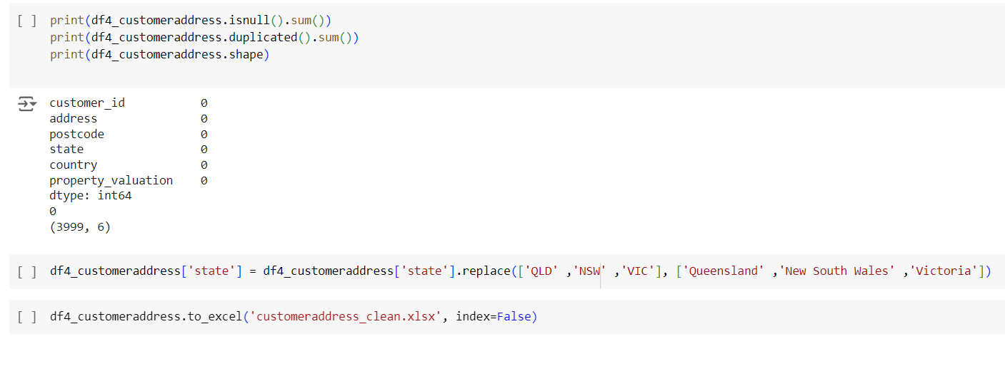
Preparing sheet four
Replace “state” with more readable values

Slide 23

Analysis & Visualization Power BI

Slide 24
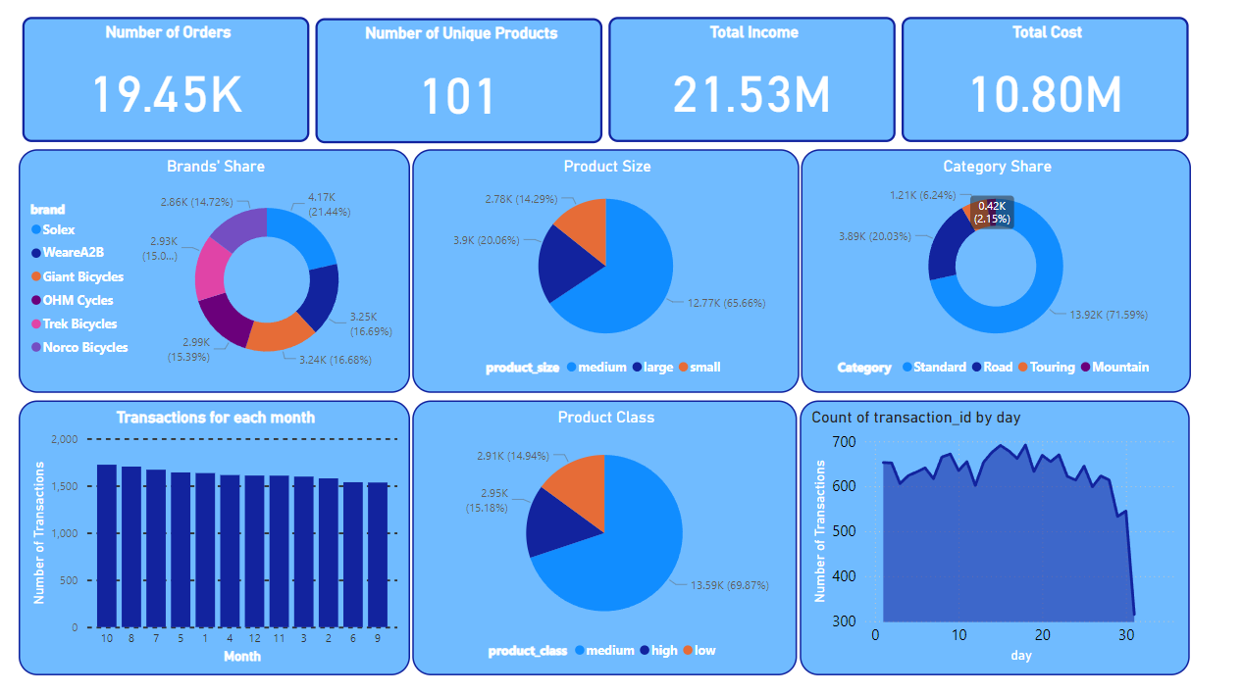
Transactions Dashboard

Slide 25
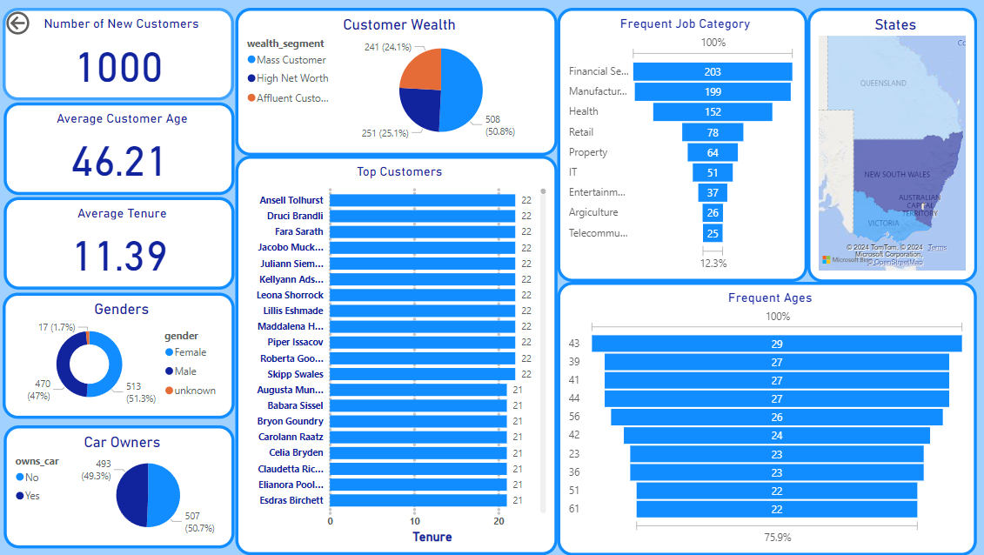
New Customers Dashboard

Slide 26
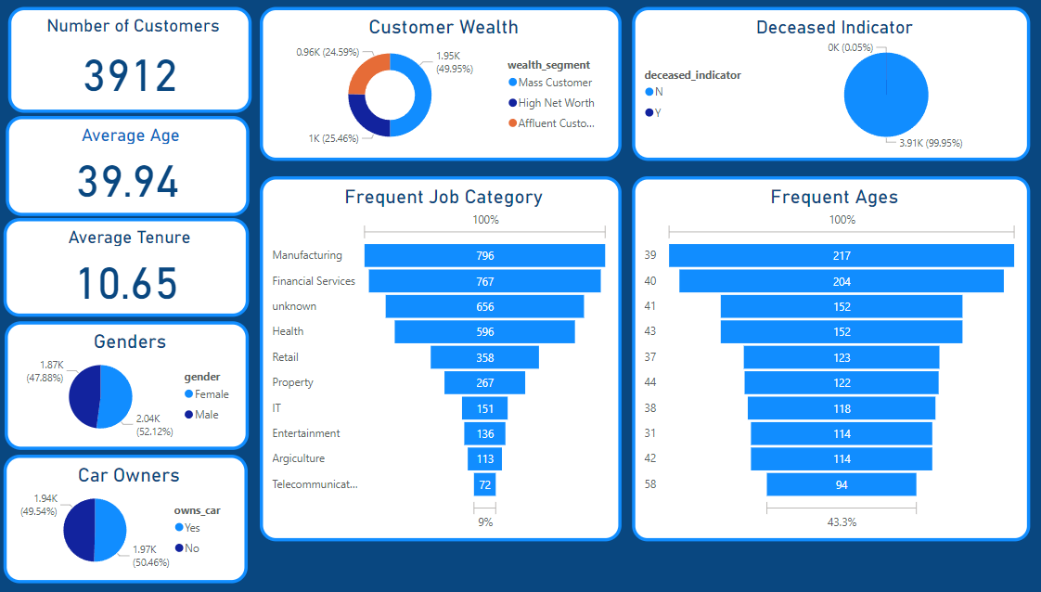
Customer Demography Dashboard

Slide 27
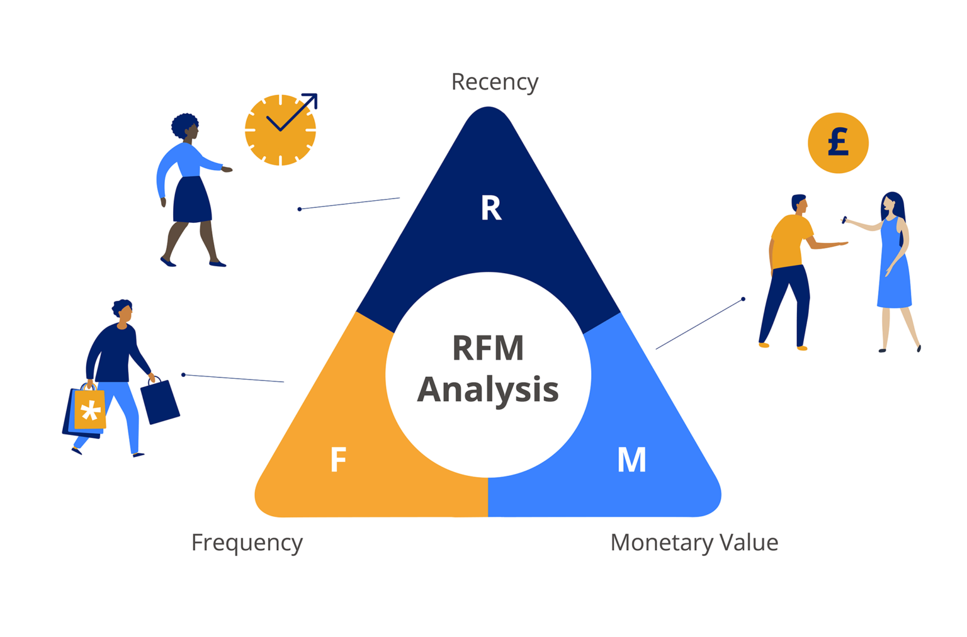
RFM Analysis

Slide 28
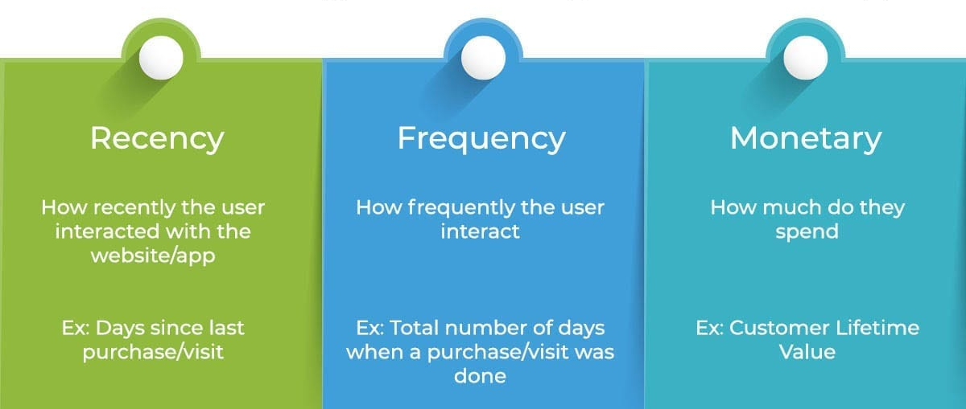
Agenda

Slide 29
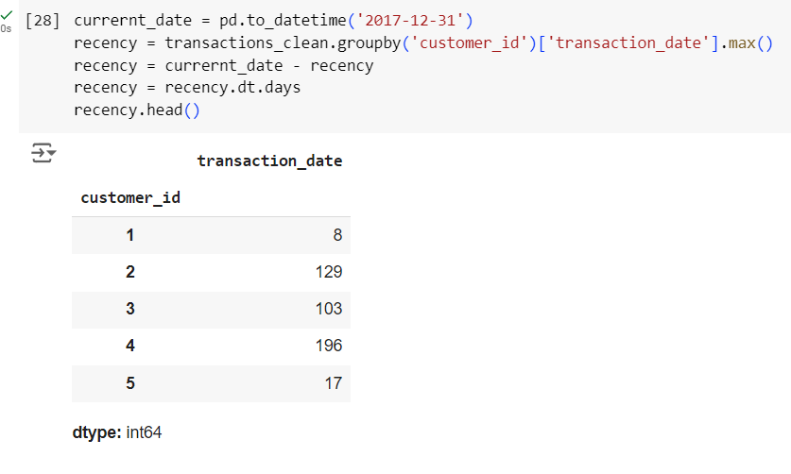
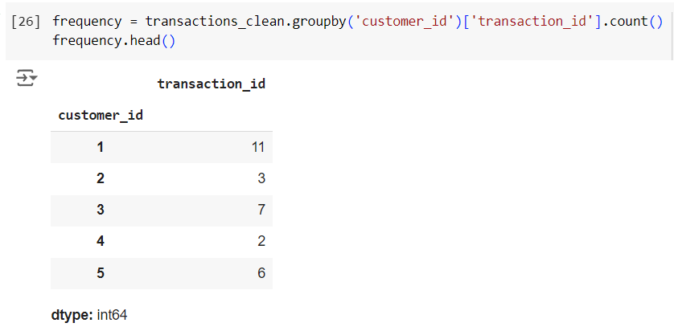
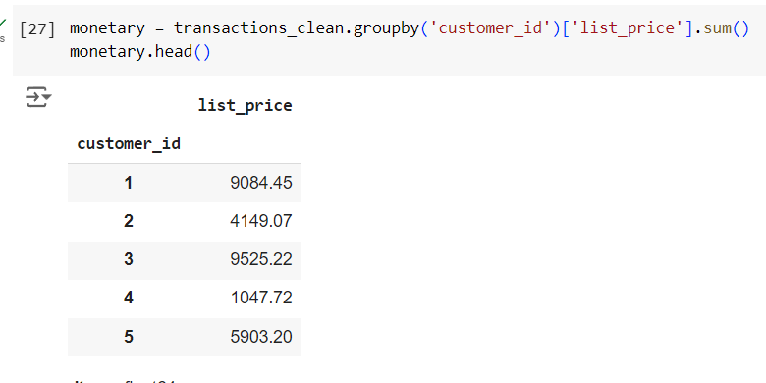
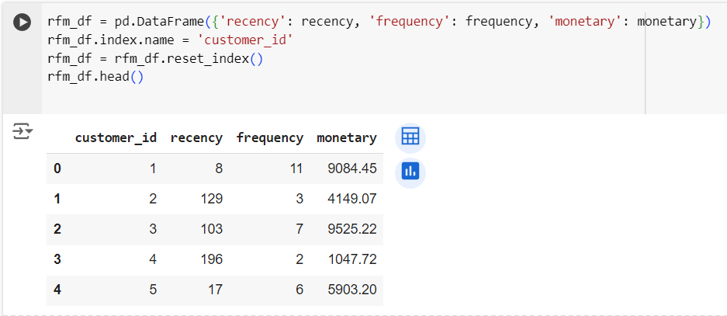
Recency, Frequency and Monetary Calculations
RFM Data

Slide 30
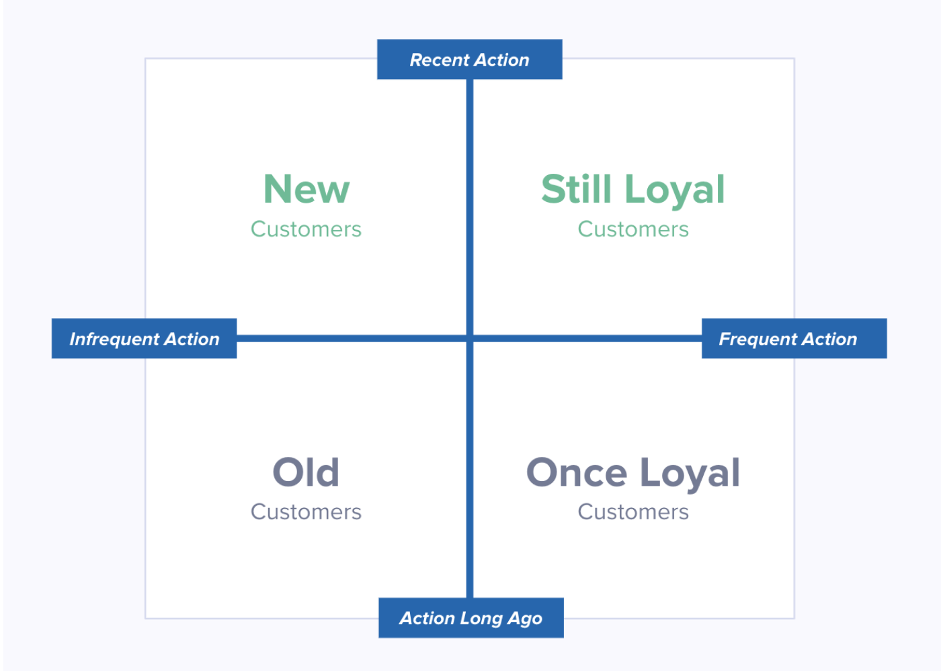

Slide 31

Forecasting Model Development
Preprocessing
Feature Selection
Data Splitting
Modeling and Evaluation

Slide 32
Data Preprocessing
Using numerical encoding for values :
Binary : (yes , no) , (male, female) , (approved , cancelled) , (Y,N).
Ordinal : (Mass , High , Affluent) (low , medium, large) .
Using one-hot encoding for categorical values like [brand] , [job_category].
Remove non relevant and no variance data.
Split and prepare training data

Slide 33
Features
Main objective of the model is predicting the standard cost and price of bikes to predict the profit
product_class
product_size
product_first_sold_date
Day , month
Brand
product_line
past_3_years_bike_related_purchases
wealth_segment
owns_car
tenure
customer_age
profit

Slide 34
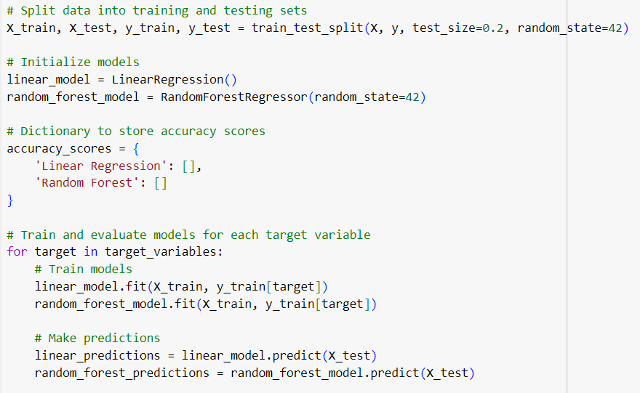
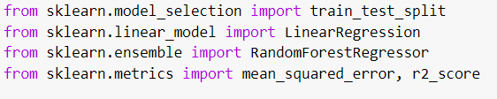
Modeling
By applying two algorithms (LinearRegression, RandomForestRegressor ) , the accuracy scores were test for each model and the selected model was the RandomForestRegressor.

Slide 35
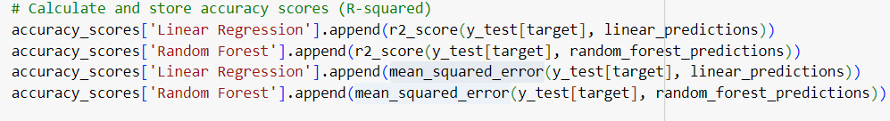
Modeling
RandomForestRegressor achieved an r2_score of 0.9998255100415782, a mean_squared_error of 13.977196031605605 for Standard cost .
r2_score of 0.9999999159641466, and mean_squared_error 0.028957953185618005 for the list price
Standard cost | Linear Regression | Random Forest
R2_score | 0.20772997015242334 | 0.9998255100415782
MSE | 63463.32830438401 | 13.977196031605605
List price | Linear Regression | Random Forest
R2_score | 0.8158296989446303 | 0.9999999159641466
MSE | 63463.328304383926 | 0.028957953185618005

Slide 36
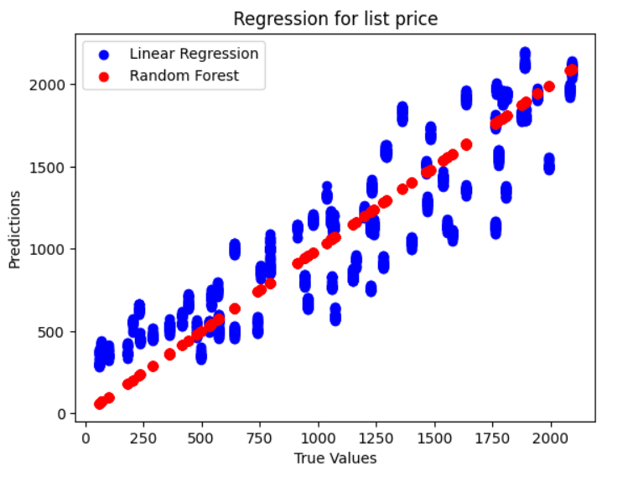
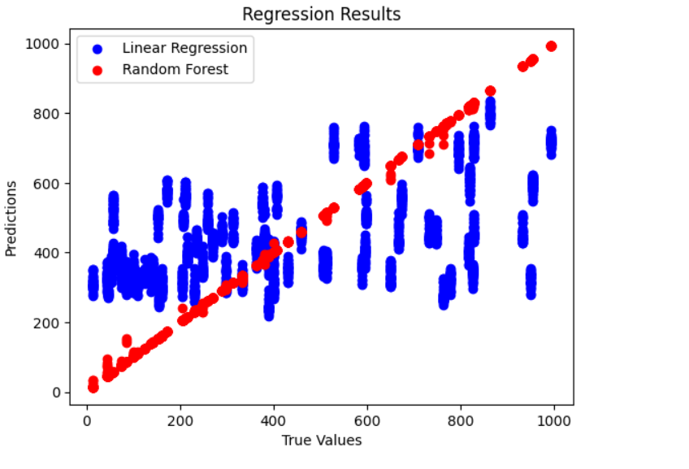
List price
Standard cost

Slide 37
How can the model be used?
Use data to prepare a plan for the next year
Predict and manage demand on brands
Prepare the budget

Slide 38

Model Deployment

Slide 39
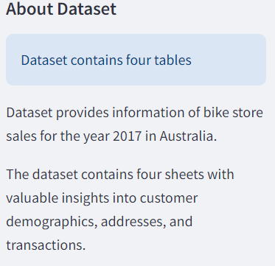
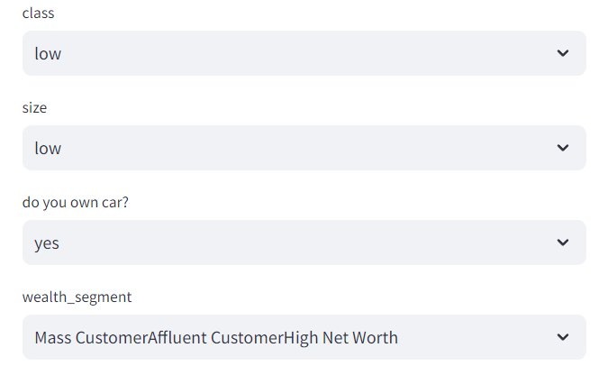
StreamLit Deployment
Predicted data saved in two data frame one for each variable.
Using streamlit extension, a web page was created to deploy the model for users
app allows users to interact with data

Slide 40
For further information
Notebooks link
Streamlite link
Feel free to connect
Preprocessing
https://www.linkedin.com/in/ahmed-mo-anwer03/
Feature Engineering & model
https://depifinalproject-rfm.streamlit.app/

Slide 41

Thank you

